Slide 1
Kuhn SSR Chapter 3
Vincent Shao

Slide 2
The Nature of Normal Science
Paradigm – represents fundamental work that has been widely accepted and guides future research and experimentation
“An object for further articulation and specification under new or more stringent conditions”
Main Questions
What is the nature of the more esoteric research that a paradigm permits?
What further problems does it leave the united group to resolve?

Slide 3

Mopping-up Operations
Paradigms encourage mopping-up operations
Actualization of the promise that a paradigm already provides
Experiments to reinforce and articulate the paradigm
Results in extensive depth in small portions of science
No focus on discovering new sorts of phenomena
What does this look like?

Slide 4
The Problems of Normal Science
Determination of fact
Matching fact with theory
Articulation of theory
Facts provided by the paradigm
Demonstration of facts in nature
Empirical work to articulate the paradigm theory
Predict factual information with theory
Difficulty creating agreement between nature and theory
Using theory to articulate the paradigm

Slide 5
Determination of Fact
Paradigm
Facts by the paradigm
Increasing the accuracy and scope of facts that are proven to be revealing by the paradigm
Use of complex and special tools (i.e. synchrotons and radiotelescopes)
Examples: boiling points, acidity of solutions, stellar position, gravities
Demonstration of facts in nature
Displays the facts provided by the paradigm acting in nature
Atwood’s machine to demonstrate Newton’s second law, Foucault’s apparatus to show the differences in the speed of light
Empirical work to articulate paradigm theory
Increasing accuracy and determination of physical constants – Pi, Avogadro’s number, Joule’s coefficient
Qualitative laws of nature – Boyle’s Law, Coulomb’s Law
Determine Important Facts
Show Facts in Nature
Empirical Work to Expand on Facts

Slide 6
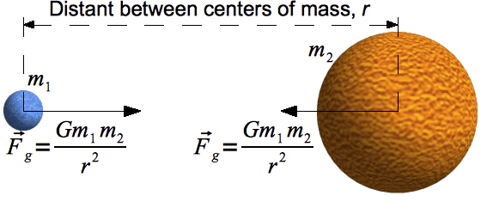
Matching Fact with Theory
Predict factual information of nature with theory
Displays a new application of the paradigm or to increase the precision of an application that already exists
Production of radio propagation curves, computation of lens characteristics
Attempts to connect nature with accepted theory
Paradigm theory is often vague and difficult to display in nature
Newton’s laws were general and had little real world applications
Multiple attempts to create a connection
Predictions with only theory were often inaccurate due to generalizations or assumptions

Slide 7
Articulation of Theory
Clarification by Reformulation
Theories were sometimes reformed in order to be more easily applied to certain situations
Leads to refinement in theory
Simultaneously experimental and theoretical

Slide 8
“The overwhelming majority of the problems undertaken by even the very best scientists usually fall into one of the three categories above” (34)

Slide 9
Outline
What is the nature of normal science and paradigms?
Paradigms in normal science – “An object for further articulation and specification under new or more stringent conditions”
Mopping-up operations – Attempts to articulate theories that the paradigm already supplies, constitutes most of what normal science is
Three types of problems in normal science
Class of facts provided by the paradigm
Encourages scientists to repeatedly improve the scope and precision of methods used to determine a previously known fact
Matching of facts with theory
Tying the behaviors of nature with existing theories
Predict factual information using theory
Articulation of theory
Using theories to demonstrate the truths given by the paradigm
Refinement of theory

